Slide 1


S
PRESTIGE INSTITUTE OF ENGINEERING MANAGEMENT AND RESEARCH
Sentiment Analysis for Social Media Presence
Artificial Intelligence and Data Science Department
GUIDED BY:
Mr. Sudhanshu Trivedi
PRESENTED BY :
Ms. Sonal Khetkar
Ms. Sheetal Parihar
Mr. Vishal Gupta
Mr. Rupesh Soniya
Mr. Anshul Patel

Slide 2
Table of contents
Sentiment Analysis for Social Media Presence
Introduction
Usecase Diagram
How it is work?
Tools and Technologies
Applications
Conclusion

Slide 3
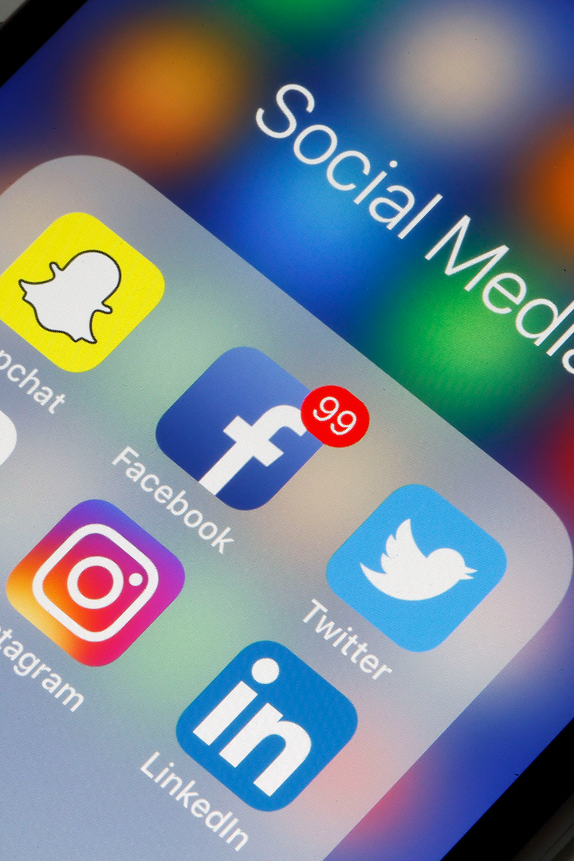
Sentiment Analysis for Social Media Presence
This problem involves developing a sentiment analysis solution specifically designed for analyzing the sentiment expressed in the social media presence of individuals and organizations.
Discover how sentiment analysis can provide valuable insights into social media trends and help businesses make data-driven decisions.

Slide 4

Introduction
Sentiment analysis is a process of assessing the emotional tone behind a series of text data, such as social media posts or customer reviews.
Sentiment analysis helps businesses understand public perception, measure brand sentiment, and identify emerging trends and patterns.

Slide 5
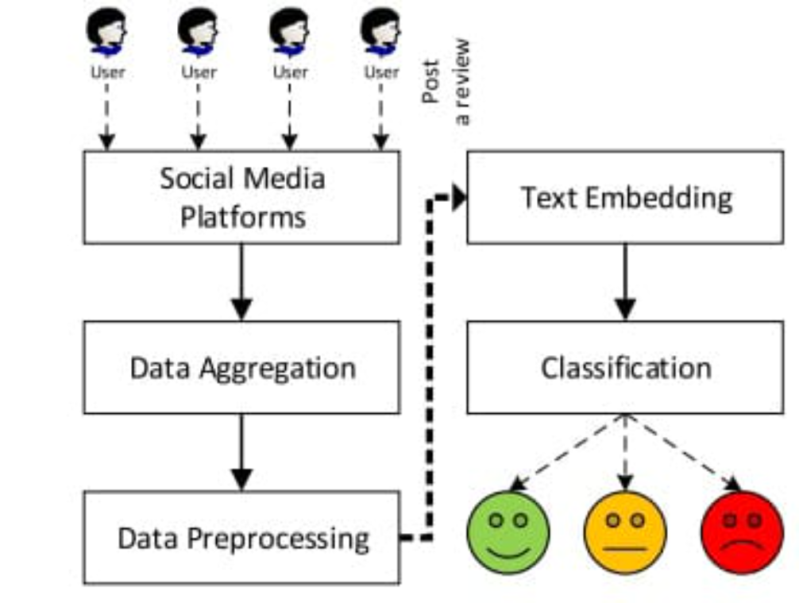
Usecase Diagram

Slide 6
How Does Sentiment Analysis Work?
1
Data Collection
Gather social media posts, comments, and reviews related to the specific topic or brand.
Natural Language Processing
2
Analyze text using machine learning algorithms to determine sentiment polarity (positive, negative, or neutral).
3
Sentiment Classification
Assign sentiment scores to individual data points and categorize them accordingly.

Slide 7





Tools and Technologies

Slide 8


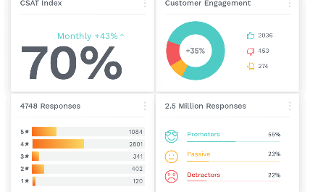
Applications of Sentiment Analysis for Social Media
Brand Reputation Management
Market Research
Customer Feedback Analysis
Learn what customers like, how they feel, and what they do to make better marketing decisions.
Keep an eye on what customers are saying about your brand online and handle it well to maintain a positive image.
Analyze customer reviews and feedback to improve products, services, and overall customer experience.

Slide 9

Conclusion
Sentiment analysis offers businesses a powerful tool to understand public sentiment on social media, driving data-backed decision-making.
It helps you understand and address the feelings of your customers, communicate effectively, and make informed decisions.
This not only saves you time and money but also leads to happier customers and business growth.
It is a win for your brand and your audience.

Slide 10

Thank You!

